Slide 1
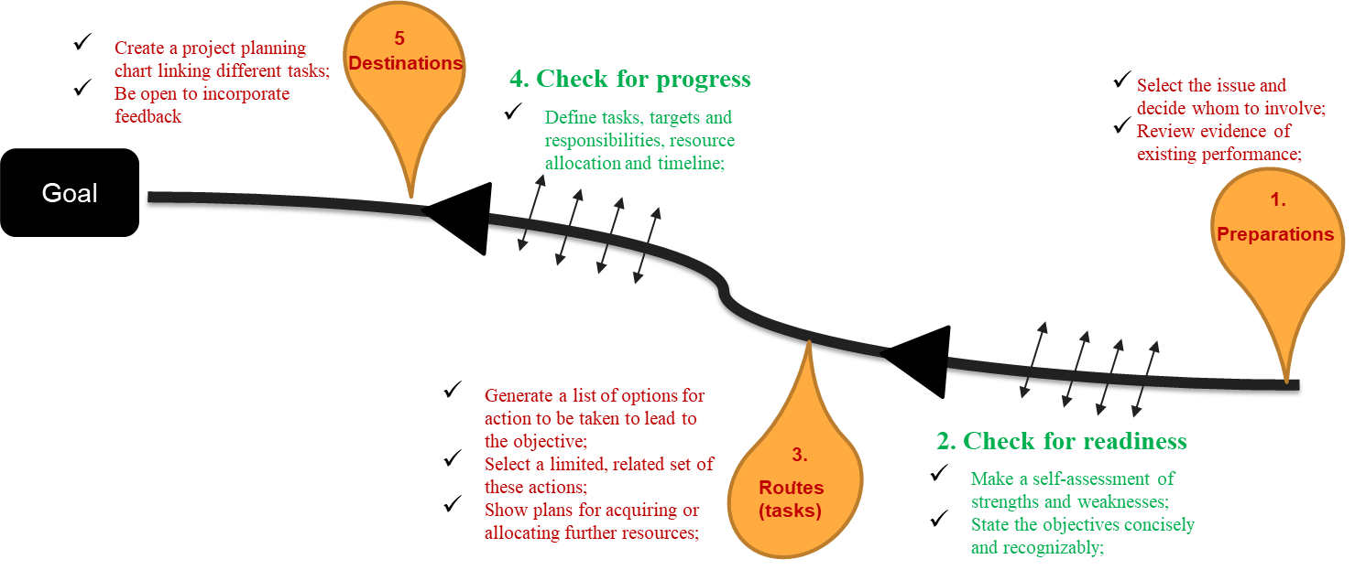
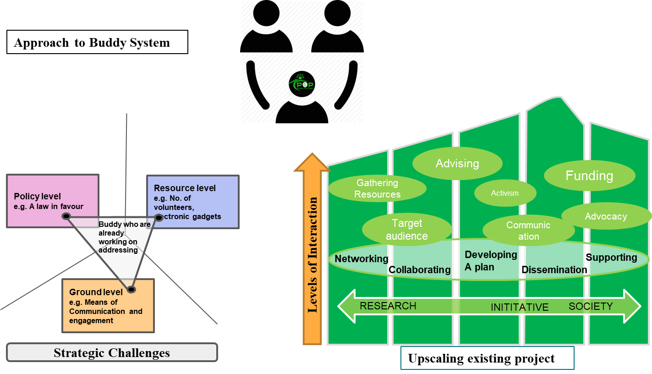
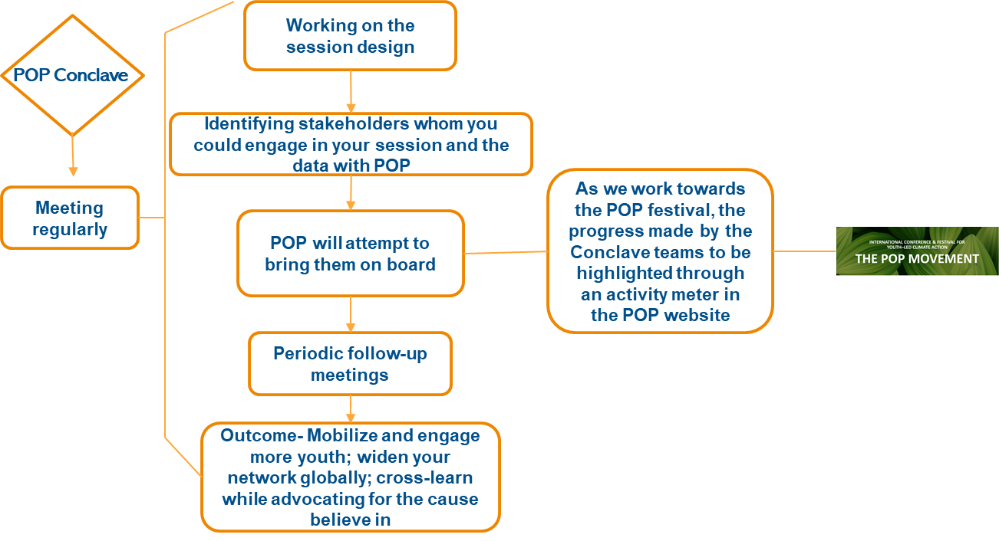
Introduction- Discussion I
Road Map to the Action Plan- Discussion II
Integrating Ideas-Discussion III
Creating a Movement-
Discussion IV
POP Conclave
Guideline Booklet

Slide 2
Questions the presentation can address
Where are we now?
What kind of research is required to move further?
Where do we want to be and how will we get there?
What are the specific goals and targets?
What resources are required?
How will inspire and mobilize people to join you?
What timescales are there for different stages of implementation?
What platforms may be used (online and offline)?
What are the tasks and routes to the achievement of targets, and means to monitor and check progress?
How the POP Movement may be able to help you?
Explore alternative strategies that may be adopted (for eg. During the COVID situation, many of us adopted different approaches to continue our work)?
*Note: Participants can try to cover as many questions as convenient based on the scale and/or stage of your project.

Slide 3
Road Map to the Action Plan
Create a project planning chart linking different tasks;
Be open to incorporate feedback
5.
Destinations
4. Check for progress
Select the issue and decide whom to involve;
Review evidence of existing performance;
Define tasks, targets and responsibilities, resource allocation and timeline;
Goal
1.
Preparations
Generate a list of options for action to be taken to lead to the objective;
Select a limited, related set of these actions;
Show plans for acquiring or allocating further resources;
2. Check for readiness
3..
Routes
(tasks)
Make a self-assessment of strengths and weaknesses;
State the objectives concisely and recognizably;

Slide 4
How do we integrate ideas?
Becoming buddies
Plastic Pollution
Recycling
Policy Level
Knowledge Integration
Becoming buddies
Ground Level
Becoming buddies
Challenges
Resource Level
Becoming buddies
Identify your challenges
Look for solutions in other action plans
Identify your buddies
Interact with your buddies
Integrate Knowledge
Work as team
Biodiversity
Sustainable fashion
Becoming buddies

Slide 5
Approach to Buddy System
A.
B.
Advising
Funding
Policy level
e.g. A law in favour
Resource level
e.g. No. of volunteers, electronic gadgets
Gathering Resources
Activism
Advocacy
Buddy who are already working on addressing
Target audience
Communication
Levels of Interaction
Networking
Developing
A plan
Supporting
Collaborating
Dissemination
Ground level
e.g. Means of Communication and engagement
RESEARCH
INITITATIVE
SOCIETY
Strategic Challenges
Upscaling existing project

Slide 6
POP Conclave at POP Festival
Working on the session design
POP Conclave
Identifying stakeholders whom you could engage in your session and the data with POP
As we work towards the POP festival, the progress made by the Conclave teams to be highlighted through an activity meter in the POP website
Meeting regularly
POP will attempt to bring them on board
Periodic follow-up meetings
Outcome- Mobilize and engage more youth; widen your network globally; cross-learn while advocating for the cause believe in

Slide 7
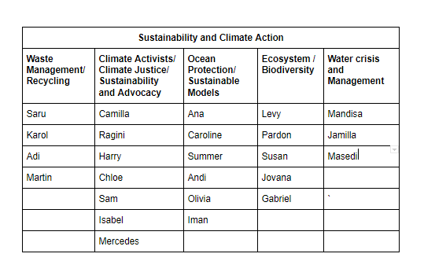
POP Conclave Groups

Slide 8
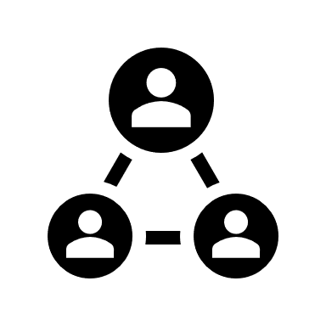
POP Conclave at POP Festival
Things to remember
How will we be involved as a group ?
Your idea and your execution, POP Movement will provide all resources and mentorship
How much time do we have ?
4 months to December 1st week
How much time we can takeout to work on it ?
Monthly/ bi-weekly meetings to re-group together
Who will design the sessions ?
Weave in your own design (a game session, technology marathon, dialogues, business hubs, educational workshops)
Whose session will it be?
Your Conclave group
What will be the topic of the sessions?
You can name the session as per the design keeping the theme alive

Slide 9
POP Conclave at POP Festival
Things to remember
How are we going to involve other stakeholders?
Do your research, collect and collate the data and provide it to the POP team. POP Movement will send out invitations and coordinate the arrangement.
Can we add more people to work with us?
The aim of this project is to mobilize young people to take action. What could be better than engaging more people in the process! A formal introduction of the new member will take place if anybody is mobilized
How can we highlight our own projects? You can design the session in a manner that requires you to present your projects during the session. Otherwise, you may submit your projects to be presented at the main platform provided at the POP Festival (More info to be shared soon)

Slide 10
POP Conclave at POP Festival
Short to long term goal -
This will be something created by you as a group to mobilize, inspire and demand action.
It will be an opportunity to associate and/or improvise your area of work/ interventions with the help of different stakeholders
This will serve as platform for you to advocate as a voice of youth for a particular issue by approaching stakeholders like businesses, academia, NGOs, communities and science and technology etc..

